Slide 2
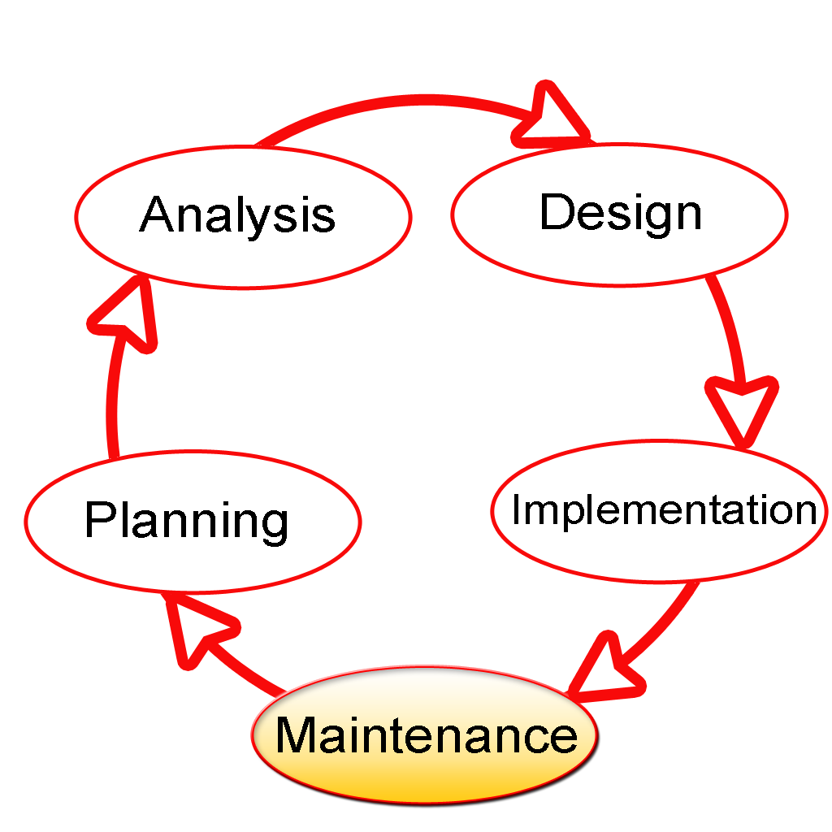
Software Development Lifecycle

Slide 3


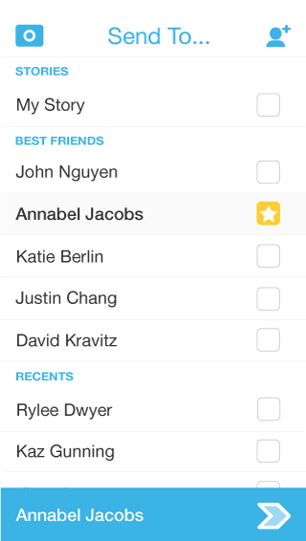

Snapchat Message Flow

Slide 4
Business Analyst
What are we trying to do / accomplish?
How can we do it with software?
What should it look like?
Notes:
Product people/customer’s bring us ideas
its our job to turn those ideas into something the developer can work with
act as a shield to prevent bad designs from becoming reality

Slide 5
Technical Management
What does it take to build / make it?
Who can do it?
How long will it take?
How much will it cost?
Are we on track?
Is everyone able to do his or her job, everyday?
Notes:
Gantt chart

Slide 6
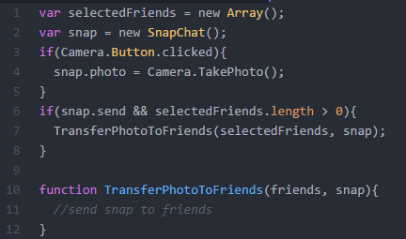
Development
Sending a snap
Take a picture
Store the picture
Identify the friend
Send the picture
Notes:
The specifications and design mockups from the Business Analysts serve as a basis for developers to implement. We take their design and write code to actually implement the design.
...

Slide 7

Quality Assurance
Does it do what it was supposed to do?
Did the camera work?
Did the snap get to the right friend?
Was it easy?
How can we make this better?
Notes:
QA can be a dual role. we’re responsible for making sure it works the way we want it to and that the way we designed it is easy to use
does it work on all the devices we want it to?
will people understand it?
we want software to be easy, people will be more inclined to use it

Slide 8
Let Your Passion Fuel You
Business Analyst
Problem Solving
Creativity
Communication Skills
Bridge Business and Development
Asking the right questions
2014 Median Salary
$82,710
Notes:
Talk about your education, work experience
PS and Creativity go together - trying to find a way to fit all of the information you need to, but not always in the same way
bridging the gap between business side (what they think they need) and dev (can it be done that way, is that the best way?)

Slide 9
Let Your Passion Fuel You
Technical Manager
People interaction (you’re a people person)
Organization (you like to be on top of things)
Team Leadership (you don’t mind owning the responsibility)
Motivator
Enjoy being involved in every step of a project
2014 Median Salary $110,000
Notes:
Talk about your education, work experience

Slide 10

Let Your Passion Fuel You
Software Engineer
Building things (Legos, Minecraft, code)
Analyzing how things work
Mathematics / formulas (A + B = C)
Problem Solving
Interest in making things better
2014 Median Salary $97,990
Notes:
Talk about your education, work experience

Slide 11
Let Your Passion Fuel You
Why software is something to consider
Awesome atmosphere (Work is fun and casual, most of the time)
Jobs pay nearly twice the national average (You get paid well)
It’s a talent-driven industry (Companies do all they can to recruit you)
Employs around a million people in the US
Adds more than $260 Billion dollars to the US economy
One of the fastest growing industries in the world
There’s a [projected] major shortage in resources (people)
Notes:
Talk about your education, work experience

Slide 12
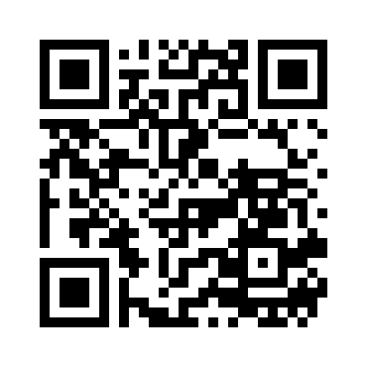
Programming Resources
https://github.com/pgorley/HickoryCareerWeek2016
Code Girl
Made With Code
Code HS
Khan Academy
Hour of Code

Slide 13
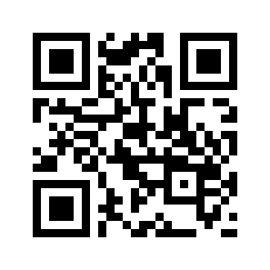
Autosoft
Autosoft - Dealer Management System
Corporate Headquarters: 61 Executive Court West Middlesex, PA 16159
Dayton Branch 241 Taylor Street Dayton, OH 45402

Slide 14
Questions?

